Slide 1
Django form
江琳

Slide 2
Html form
In HTML, a form is a collection of elements inside <form>...</form> that allow a visitor to do things like enter text, select options, manipulate objects or controls, and so on, and then send that information back to the server.

Slide 3
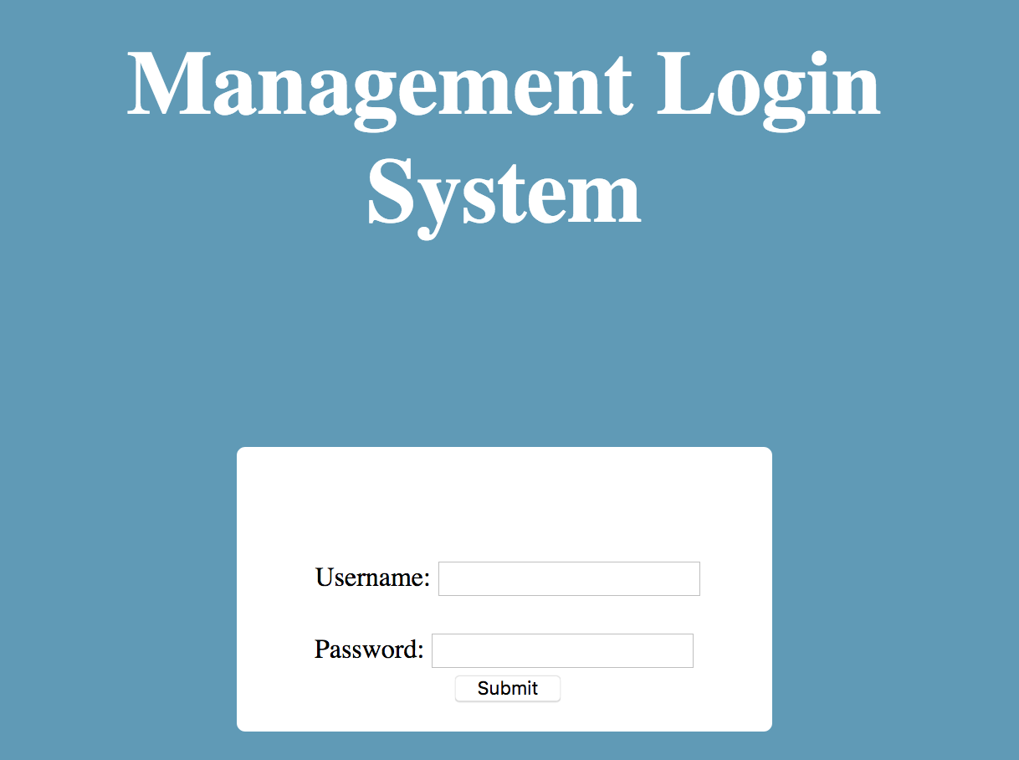
Html form
Do you remember the form we write for backstage login page in index.html?

Slide 4

<form method="post"> {% csrf_token %} <p style="height: 15px"> {% for msg in messages %} <span class="{{ msg.tags }}">{{ msg }}</span> {% endfor %} </p> <p> <label>Username:</label> <input type="text" placeholder="username" name="username"> </p> <p> <label>Password:</label> <input type="password" placeholder="password" name="password"> </p> <input type="submit" value="Submit"> </form>

Slide 5
form

Slide 6
Django form
Django’s form is simplify and automate, and it more securely than most programmers would be able to do in code they wrote themselves.

Slide 7
Django form
Let’s rewrite the backstage login page using Django Form.
Firstly, we need create a file named forms.py in the application of books.

Slide 8

the Froms
We already know what we want our HTML form to look like. Our starting point for it in Django is this:
from django import forms class LoginForm(forms.Form): username = forms.CharField(widget=forms.TextInput( attrs={'placeholder': 'username'})) password = forms.CharField(widget=forms.PasswordInput( attrs={'placeholder': 'password'} ))

Slide 9
the Froms
This defines a Form class with two fields username and password

Slide 10

The Views
from .forms import LoginForm class Index(View): def get(self, request): form = LoginForm return render(request, ‘backstage/index.html’, {‘form’:form}) def post(self, request): form = LoginForm(request.POST) if form.is_valid(): user = authenticate( username=form.cleaned_data[‘username’], password=form.cleaned_data[‘password’]) if user and user.is_superuser: login(request, user) return redirect(reverse(‘bs_list’)) else: messages.error(request, ‘username or password is incorrect！’) return redirect(reverse(‘index’)) return render(request, 'backstage/index.html', {'form': form})

Slide 11

The Template
Now we don’t need to do much in index.html
<form method="post"> {% csrf_token %} <p> {% for msg in messages %} <span class="{{ msg.tags }}">{{ msg }}</span> {% endfor %} </p>
{{ form.as_p }} <input type="submit" value="Submit"> </form>

Slide 12
Django form
If we arrive at this view with a GET request, it will create an empty form instance and place it in the template context to be rendered.

Slide 13
Django form
If the form is submitted using a POST request, the view will once again create a form instance and populate it with data from the request:
form = LoginForm(request.POST)
This is called “binding data to the form”

Slide 14
Django form
A Form instance has an is_valid() method, which runs validation routines for all its fields. When this method is called, if all fields contain valid data, it will:
return True
place the form’s data in its cleaned_data attribute.
it’s not True, we go back to the template with the form.

Slide 15

Django form
Assume we limit the length of username is 16 in maximum.
class LoginForm(forms.Form): username = forms.CharField(widget=forms.TextInput( attrs={'placeholder': 'username'})) password = forms.CharField(widget=forms.PasswordInput( attrs={'placeholder': 'password'} )) def clean_username(self): username = self.cleaned_data['username'] if len(username) > 16: raise ValidationError('username is to long') return username

Slide 16
Django form
Form.is_vaild() will return False if length of username is longer than 16.

Slide 17

Build-in field classes
When you create a Form class, the most important part is defining the fields of the form.
from django import forms class LoginForm(forms.Form): username = forms.CharField(widget=forms.TextInput( attrs={'placeholder': 'username'})) password = forms.CharField(widget=forms.PasswordInput( attrs={'placeholder': 'password'} ))

Slide 18
Build-in field classes
https://docs.djangoproject.com/en/1.11/ref/forms/fields/
BooleanField
CharField
ChoiceField
DateTimeField
FileField

Slide 19
Build-in field widgets
A widget is Django’s representation of an HTML input element. The widget handles the rendering of the HTML, and the extraction of data from a GET/POST dictionary that corresponds to the widget.

Slide 20
Build-in field widgets
https://docs.djangoproject.com/en/1.11/ref/forms/widgets/
from django import forms class LoginForm(forms.Form): username = forms.CharField(widget=forms.TextInput( attrs={'placeholder': 'username'})) password = forms.CharField(widget=forms.PasswordInput( attrs={'placeholder': 'password'} ))

Slide 21
modelform

Slide 22
modelform
If you’re building a database-driven app, chances are you’ll have forms that map closely to Django models.
For instance, we have Book model in our Library Management System, and we want to create a form that lets administrator create new book.

Slide 23
modelform
For this reason, Django provides a helper class that lets you create a Form class from a Django model.
Do you remember we have a CreateAuthor view used to create author of book? Lets modify it.

Slide 24

The view
class CreateAuthor(CreateView): form_class = AuthorForm template_name = 'backstage/create_author.html' def get_success_url(self): messages.success(self.request, 'Create Success!') return resolve_url('create_author')

Slide 25
The form
In forms.py
from django.forms import ModelForm from .models import Author class AuthorForm(ModelForm): class Meta: model = Author fields = '__all__'
Set the fields attribute to the special value '__all__' to indicate that all fields in the model should be used.

Slide 26
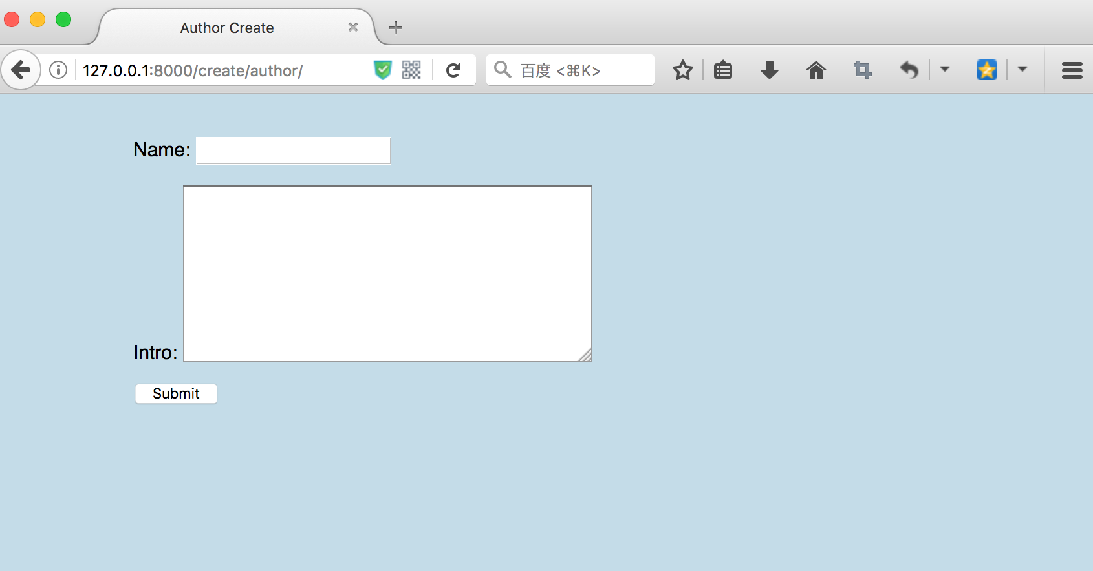
modelform

Slide 27
Validation
Model validation is triggered after the form’s clean() method is called.
You can override the clean() method on a model form to provide additional validation.
Let write a clean() method to avoid user to create repeated author.

Slide 28
Validation
from django.forms import ModelForm, ValidationError from .models import Author class AuthorForm(ModelForm): class Meta: model = Author fields = '__all__' def clean_name(self): name = self.cleaned_data['name'] if Author.objects.filter(name=name).exists(): raise ValidationError('Author is already exist!') return name

Slide 29
Validation
Now if we try to create a user which already exist, a error message will show up.

Slide 30
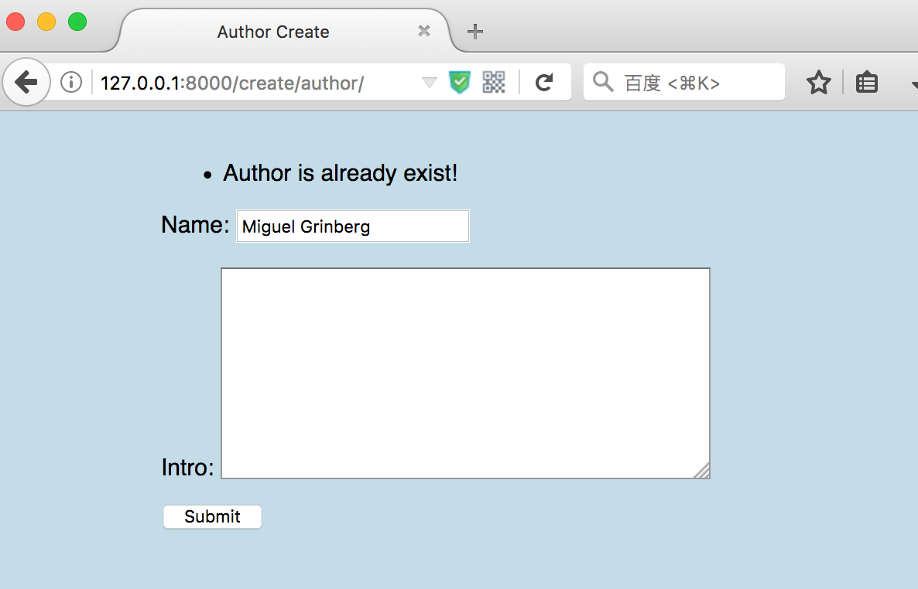
Validation

Slide 31
reference
https://docs.djangoproject.com/en/1.11/topics/forms/
https://docs.djangoproject.com/en/1.11/ref/forms/fields/
https://docs.djangoproject.com/en/1.11/ref/forms/widgets/
https://docs.djangoproject.com/en/1.11/topics/forms/modelforms/

Slide 32
Questions?

